Slide 1
Internet Protocols
IP addressing, IP, ICMP, ARP, IGMP, IPV4, IPV6, Sub netting for IPV4

Slide 2
IP addressing
Refers to internet protocol
Identity of a device in a network
Each and every device connected to network has a unique and universal IP address.
Communication in the network layer is host to host
A computer in the network needs to communicate with others in the network.
We need a global addressing scheme (logical addressing)
IP address: logical address in the network layer of TCP/IP protocol suite
Two versions:
IPV4
IPV6

Slide 3
Internet Protocol (IP)
Identity of a device in a network
Communication at the network layer is host to host
A device in a network needs to communicate with others
Is a logical address in the network layer of TCIP/IP protocol suite
Two versions.
IPV4
IPV6.

Slide 4
IPV4 address
32-bit address that uniquely and universally defines the connection of a device (for example, a computer or a router) to the Internet
The address space of IPv4 is 232or 4,294,967,296.
But restrictions!!
IPV4 address notation:
Dotted decimal
Binary

Slide 5
Example 1
Change the following IP address from binary notation to dotted-decimal notation.
10000001 00001011 00001011 11101111
Solution
129.11.11.239

Slide 6
Example 2
Change the following IP address from dotted-decimal notation to binary notation:
111.56.45.78
Solution
01101111 00111000 00101101 01001110

Slide 7
Example 3
Find the error in the following IP Address
111.56.045.78
Solution
There are no leading zeroes in
Dotted-decimal notation (045)

Slide 8
Example 3 (continued)
Find the error in the following IP Address
75.45.301.14
Solution
In decimal notation each number <= 255
301 is out of the range

Slide 9
Example 4
Change the following binary IP address
Hexadecimal notation
10000001 00001011 00001011 11101111
Solution
0X810B0BEF or 810B0BEF16

Slide 10
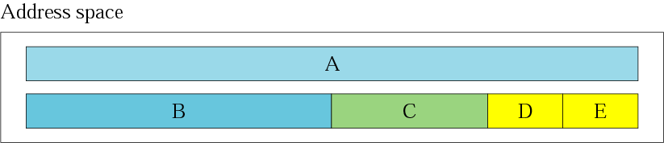
Figure 4-2
Occupation of the address space

Slide 11
In classful addressing the address space is
divided into 5 classes:
A, B, C, D, and E.

Slide 12
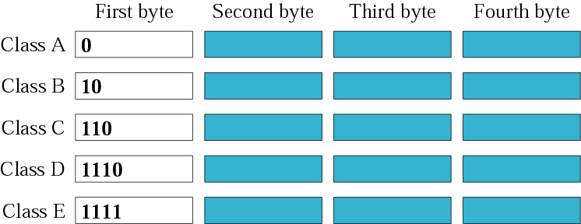
Figure 4-3
Finding the class in binary notation

Slide 13
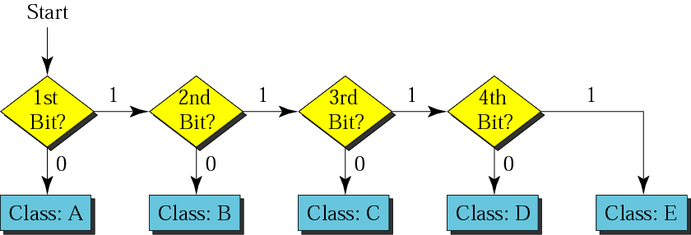
Figure 4-4
Finding the address class

Slide 14
Example 5
Show that Class A has
2³¹ = 2,147,483,648 addresses

Slide 15
Example 6
Find the class of the following IP addresses
00000001 00001011 00001011 11101111
11000001 00001011 00001011 11101111
Solution
00000001 00001011 00001011 11101111
1st is 0, hence it is Class A
11000001 00001011 00001011 11101111
1st and 2nd bits are 1, and 3rd bit is 0 hence, Class C

Slide 16
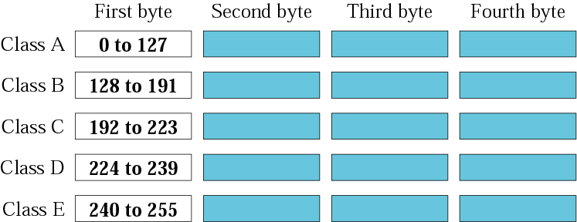
Figure 4-5
Finding the class in decimal notation

Slide 17
Example 7
Find the class of the following addresses
158.223.1.108
227.13.14.88
Solution
158.223.1.108
1st byte = 158 (128<158<191) class B
227.13.14.88
1st byte = 227 (224<227<239) class D

Slide 18
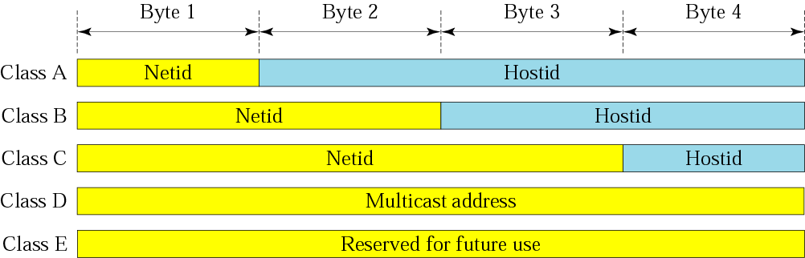
Figure 4-6
Netid and hostid

Slide 19
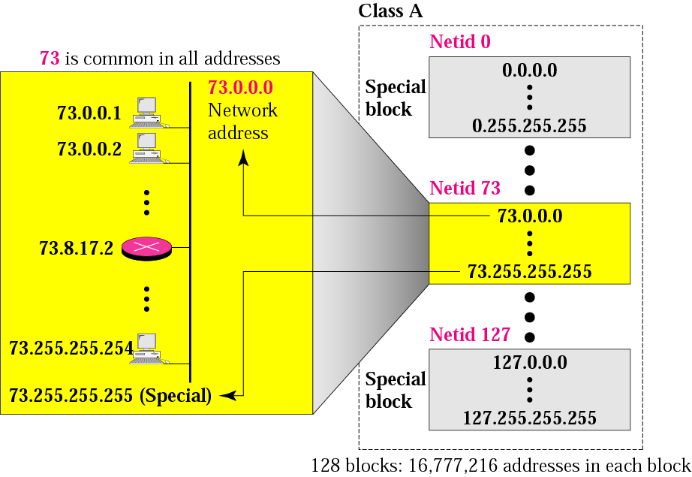
Figure 4-7
Blocks in class A

Slide 20
Class A networks (/8)
Any class A network has a total of 7 bits for the network id (bit 8th is always set to 0) and 24 bits for the Host id.
Number of network=pow(2,7)=128
We subtract 2 because 0.0.0.0 is reserved for the default router and 127.0.0.0 is reserved for loop back function. So we have 126 distinct networks in class A.
Number of hosts in each network=pow(2,24)=16,777,216
Subtract 2 because all 0;s referred to the network address and all 1’s refer to broadcast address.
So total number of distinct host address=16,777,214
Covers 50% of total address space

Slide 21

Millions of class A addresses are wasted.

Slide 22
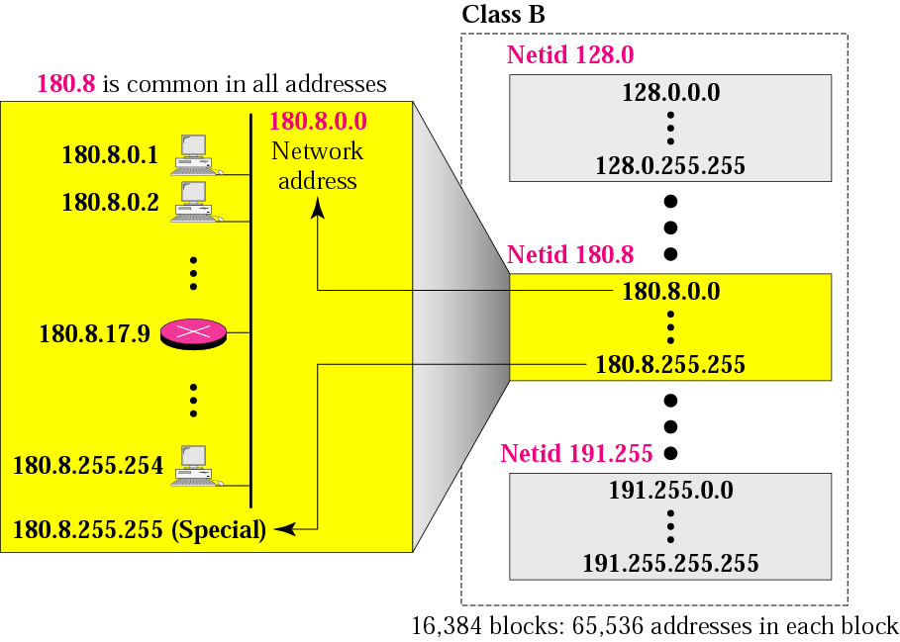
Figure 4-8
Blocks in class B

Slide 23
Class B networks (/16)
Number of network addresses=pow(2,14)=16,384
Number of hosts=pow(2,16)-2=65,534
Since the entire /16 address block contains pow(2,14)*pow(2,16)=pow(2,30), it represents 25% of the total IPV4 unicast address space.

Slide 24
Many class B addresses are wasted.

Slide 25
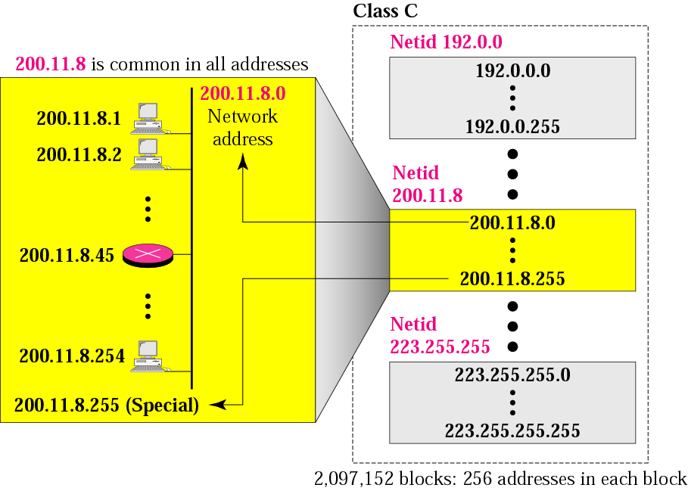
Figure 4-9
Blocks in class C

Slide 26
Class C networks (/24)
Number of networks=pow(2,21)
Number of hosts=pow(2,8)-2=254
The entire class contains pow(2,21)*pow(2,8)=pow(2,29)
Covers 12.5% of the entire IPV4 address space

Slide 27
The number of addresses in a class C block is smaller than the needs of most organizations.

Slide 28
Class D addresses are used for multicasting; there is only one block in this class.

Slide 29
Class E addresses are reserved for special purposes; most of the block is wasted.

Slide 30
Network Addresses
The network address is the first address in the block.
The network address defines the network to the rest of the Internet.
Given the network address, we can find the class of the address, the block, and the range of the addresses in the block

Slide 31
In classful addressing, the network address (the first address in the block) is the one that is assigned to the organization.

Slide 32
Example 8
Given the network address 132.21.0.0, find the
class, the block, and the range of the addresses
Solution
The 1st byte is between 128 and 191.
Hence, Class B
The block has a netid of 132.21.
The addresses range from
132.21.0.0 to 132.21.255.255.

Slide 33
.
Mask
A mask is a 32-bit binary number.
The mask is ANDeD with IP address to get
The block address (Network address)
Mask And IP address = Block Address

Slide 34
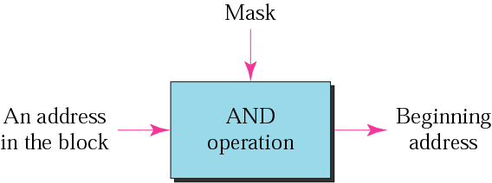
Figure 4-10
Masking concept

Slide 35
The network address is the beginning address of each block. It can be found by applying the default mask to any of the addresses in the block (including itself). It retains the netid of the block and sets the hostid to zero.

Slide 36
Default Mask
Class A default mask is 255.0.0.0
Class B default mask is 255.255.0.0
Class C Default mask 255.255.255.0

Slide 37
SUBNETTING

Slide 38
In subnetting, a network is divided into several smaller sub networks with each sub network (subnet) having its own subnetwork address. As we know an IP address is 32 bit long.
A portion of the address indicates the network and a portion indicates the host on the network.
This means that there is a hierarchy in IP addressing. To reach a host on the internet, we must first reach the network using the first portion of the address.
Then we must reach the host itself using the second portion. In other words, IP addresses are designed with two levels of hierarchy.

Slide 39
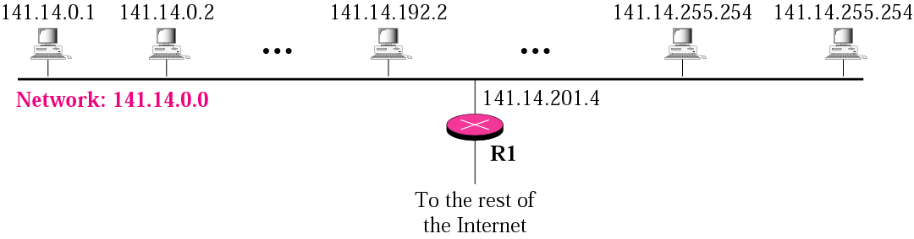
Figure 5-1
A network with two levels of hierarchy (not subnetted)

Slide 40
However, often an organization needs to assemble the hosts into groups: the network needs to be divided into several subnetworks (subnets). For example, a university may want to group its hosts according to the department. In this case, the university has one network address, but needs several subnetwork addresses. The outside world knows the organization by its network address. Inside the organization each subnetwork is recognized by its subnetwrok address. In subnetting, the network is divided into several smaller groups with each subnet having its own subnetork address.
Getting a second network address would be hard to do since network addresses are scarce.
The solution is to allow a network to be split into several parts for internal use but still act like a single network to the outside world. Instead of classful two level hierarchy, subnetting supports a three level hierarchy.
In three level addressing, we have three levels: site, subnet and host

Slide 41
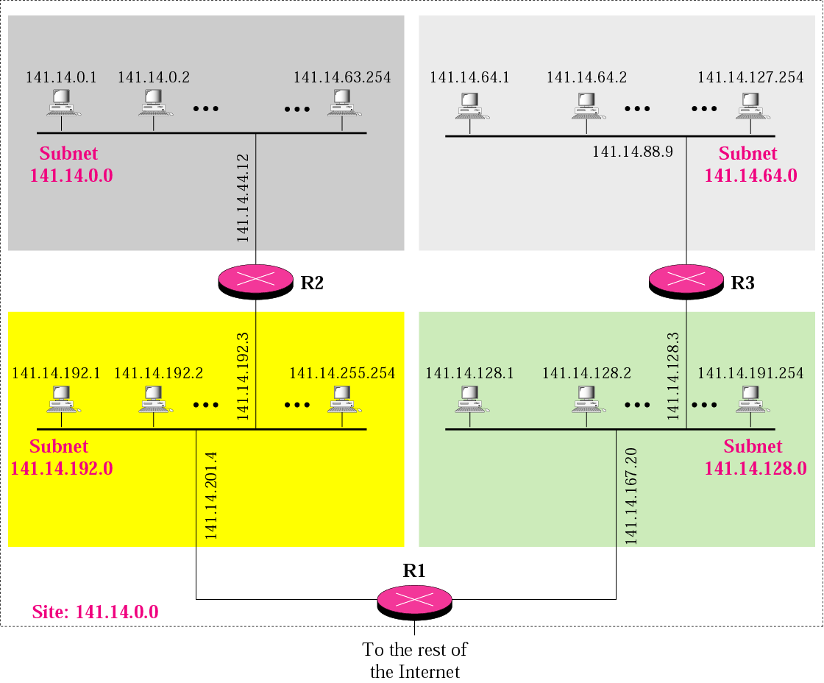
A network with three levels of
hierarchy (subnetted)

Slide 42
Note
Subnetting is done by borrowing bits from the host part and add them the network part

Slide 43
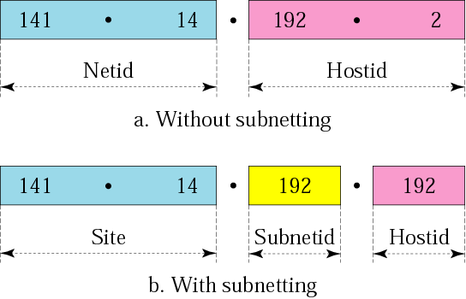
Figure 5-3
Addresses in a network with and without subnetting

Slide 44
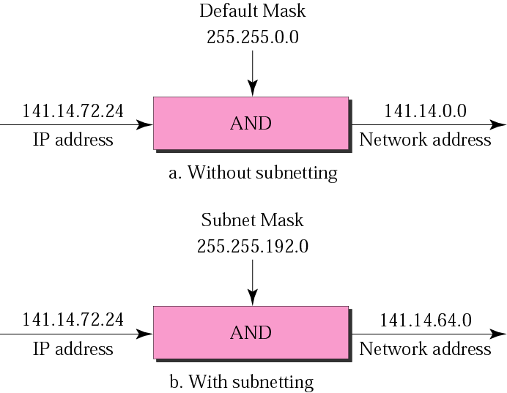
Figure 5-5
Default mask and subnet mask

Slide 45
Finding the Subnet Address
Given an IP address, we can find the subnet address the same way we found the network address. We apply the mask to the address. We can do this in two ways: straight or short-cut.

Slide 46
Straight Method
In the straight method, we use binary notation for both the address and the mask and then apply the AND operation to find the subnet address.

Slide 47
Example 9
What is the subnetwork address if the destination address is 200.45.34.56 and the subnet mask is 255.255.240.0?

Slide 48
Solution
11001000 00101101 00100010 00111000
11111111 11111111 11110000 00000000
11001000 00101101 00100000 00000000
The subnetwork address is 200.45.32.0.

Slide 49
Short-Cut Method
** If the byte in the mask is 255, copy the byte in the address.
** If the byte in the mask is 0, replace the byte in the address with 0.
** If the byte in the mask is neither 255 nor 0, we write the mask and the address in binary and apply the AND operation.

Slide 50
Example 10
What is the subnetwork address if the destination address is 19.30.80.5 and the mask is 255.255.192.0?
Solution
See next slide

Slide 51
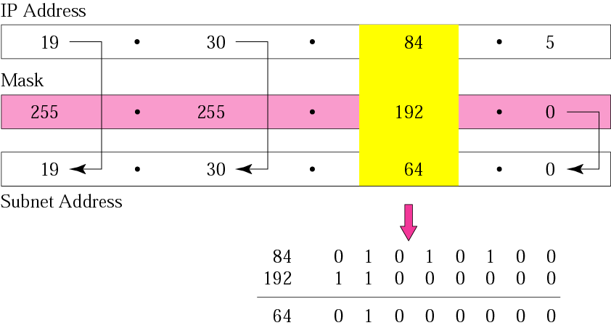
Figure 5-6
Solution

Slide 52
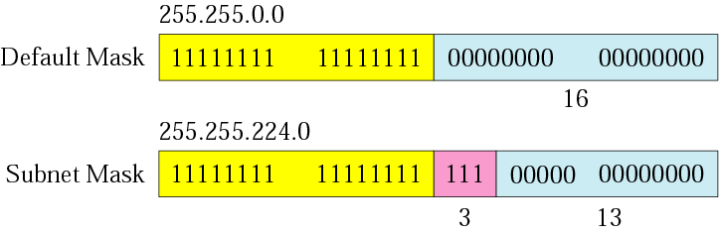
Figure 5-7
Comparison of a default mask and
a subnet mask

Slide 53
The number of subnets must be a power of 2.

Slide 54
Example 11
A company is granted the site address 201.70.64.0 (class C). The company needs six subnets. Design the subnets.
Solution
The number of 1s in the default mask is 24 (class C).

Slide 55
Solution (Continued)
The company needs six subnets. This number 6 is not a power of 2. The next number that is a power of 2 is 8 (2³). We need 3 more 1s in the subnet mask. The total number of 1s in the subnet mask is 27 (24 + 3).
The total number of 0s is 5 (32 − 27). The mask is

Slide 56
Solution (Continued)
11111111 11111111 11111111 11100000
or
255.255.255.224
The number of subnets is 8.
The number of addresses in each subnet is 2⁵ (5 is the number of 0s) or 32.
See Next slide

Slide 57
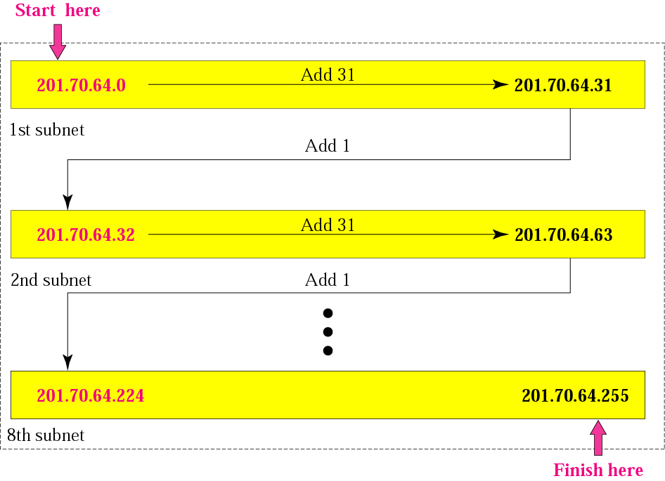
Figure 5-8
Example 3

Slide 58
Example 12
A company is granted the site address 181.56.0.0 (class B). The company needs 1000 subnets. Design the subnets.
Solution
The number of 1s in the default mask is 16 (class B).

Slide 59
Solution (Continued)
The company needs 1000 subnets. This number is not a power of 2. The next number that is a power of 2 is 1024 (2¹⁰). We need 10 more 1s in the subnet mask.
The total number of 1s in the subnet mask is 26 (16 + 10).
The total number of 0s is 6 (32 − 26).

Slide 60
Solution (Continued)
The mask is
11111111 11111111 11111111 11000000
or
255.255.255.192.
The number of subnets is 1024.
The number of addresses in each subnet is 2⁶ (6 is the number of 0s) or 64.

Slide 61
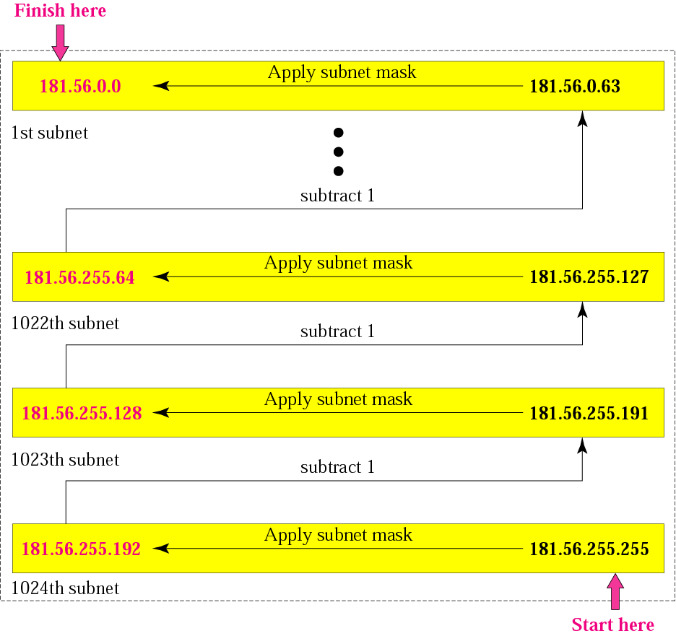
Figure 5-9
Example 4

Slide 62
Example: a router outside the organization receives a packet with destination address 190.240.7.91. show how it finds the network address to route the packet.
Solution
The router looks at the first bye of the address to find the class. It is class B.
The default mask for class B is 255.255.0.0. the outer ANDs this mask with the address to get 190.240.0.0
The router looks in its routing table to find out how to route the packet to this destination.

Slide 63
Example: a router inside the organization receives a packet with destination address 190.240.33.91. show how it finds the subnetwork address to route the packet.
Solution
The router must know the mask. Let it is /19.
The router applies the mask to the address 190.240.33.91. the subnetwork address is 190.240.32.0
The router looks in its routing table to find out how to route the packet to this destination.

Slide 64
CLASSLESS
ADDRESSING

Slide 65
The idea of classful addressing has many problems. The minimum no of addresses granted to an organization was 256 (class C) and the maximum number was 16,777,216 (class A). In between these limits an organization could have a class B block or several class C blocks. However, the choices were limited. In addition, what about a small business that needed only 16 addresses? Or a household that needed only two addresses?
An ISP (organization that provides internet access for individuals, small and mid size organization). An ISP can be granted several class B or C blocks then subdivide the range of addresses (in groups of 2, 4, 8 or 16 addresses), giving a range to a household or a small business.

Slide 66
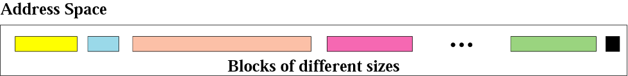
Figure 5-13
Variable-length blocks
Variable length blocks that belong to no class
The entire address space is divided into blocks of variable sizes
No of addresses in a block must be a power of 2
First address must be evenly divisible by the number of addresses

Slide 67
Number of Addresses in a Block
There is only one condition on the number of addresses in a block; it must be a power of 2 (2, 4, 8, . . .). A household may be given a block of 2 addresses. A small business may be given 16 addresses. A large organization may be given 1024 addresses.

Slide 68
Beginning Address
The beginning address must be evenly divisible by the number of addresses. For example, if a block contains 4 addresses, the beginning address must be divisible by 4. If the block has less than 256 addresses, we need to check only the rightmost byte. If it has less than 65,536 addresses, we need to check only the two rightmost bytes, and so on.

Slide 69
Example 16
Which of the following can be the beginning address of a block that contains 1024 addresses?
205.16.37.32 190.16.42.0 17.17.32.0 123.45.24.52
Solution
To be divisible by 1024, the rightmost byte of an address should be 0 and the second rightmost byte must be divisible by 4. Only the address 17.17.32.0 meets this condition.

Slide 70
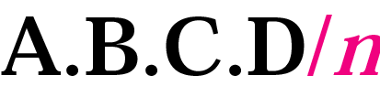
Figure 5-14
Slash notation

Slide 71
Slash notation is also called CIDR (classless inter domain routing) notation.

Slide 72
Example 17
A small organization is given a block with the beginning address and the prefix length 205.16.37.24/29 (in slash notation). What is the range of the block?

Slide 73
Solution
The beginning address is 205.16.37.24. To find the last address we keep the first 29 bits and change the last 3 bits to 1s.
Beginning: 11001111 00010000 00100101 00011000
Ending : 11001111 00010000 00100101 00011111
There are only 8 addresses in this block.

Slide 74
Example 17 cont’d
We can find the range of addresses in Example 17 by another method. We can argue that the length of the suffix is 32 − 29 or 3. So there are 2³ = 8 addresses in this block. If the first address is 205.16.37.24, the last address is 205.16.37.31 (24 + 7 = 31).

Slide 75
A block in classes A, B, and C can easily be represented in slash notation as A.B.C.D/ n where n is either 8 (class A), 16 (class B), or 24 (class C).

Slide 76
Example 18
What is the network address if one of the addresses is 167.199.170.82/27?
Solution
The prefix length is 27, which means that we must keep the first 27 bits as is and change the remaining bits (5) to 0s. The 5 bits affect only the last byte. The last byte is 01010010. Changing the last 5 bits to 0s, we get 01000000 or 64. The network address is 167.199.170.64/27.

Slide 77
Example 19
An organization is granted the block 130.34.12.64/26. The organization needs to have four subnets. What are the subnet addresses and the range of addresses for each subnet?
Solution
The suffix length is 6. This means the total number of addresses in the block is 64 (2⁶). If we create four subnets, each subnet will have 16 addresses.

Slide 78
Solution (Continued)
Let us first find the subnet prefix (subnet mask). We need four subnets, which means we need to add two more 1s to the site prefix. The subnet prefix is then /28.
Subnet 1: 130.34.12.64/28 to 130.34.12.79/28.
Subnet 2 : 130.34.12.80/28 to 130.34.12.95/28.
Subnet 3: 130.34.12.96/28 to 130.34.12.111/28.
Subnet 4: 130.34.12.112/28 to 130.34.12.127/28.
See Figure 5.15

Slide 79
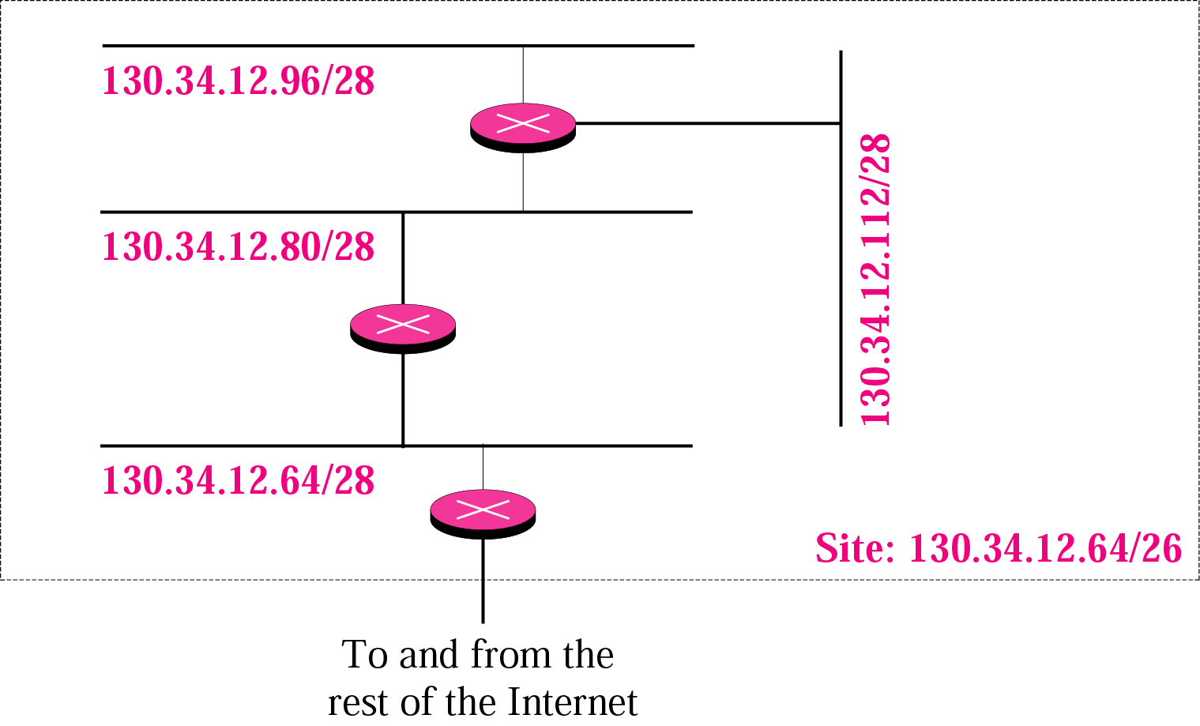
Figure 5-15
Example 19 cont’d

Slide 80
Netid guidelines
Must be unique to the IP internetwork
Can’t begin with the number 127. the number 127 in the class A is reserved for internal loopback functions.
All bits within the netid can’t be set to 1. all 1’s in the netid are for broadcast address.
All bits within the netid can’t be set to 0.

Slide 81
Hostid guidelines
IP address= net id + host id
The hostid must be unique to the netid
All bits witin hostid can’t be set to 1. reserved for broadcast address to send packet to all hosts on a network
All bits within hostid can’t be set to 0, this is reserved to denote the netid.

Slide 82
Address class | First network id | Last network id
Class A | 1.0.0.0 | 126.0.0.0
Class B | 128.0.0.0 | 191.255.0.0
Class C | 192.0.0.0 | 223.255.255.0

Slide 83
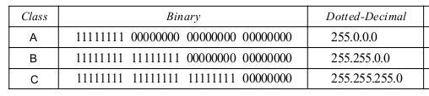
Default Masks
Help finding netid and hosid

Slide 84
Find first address/last in the block
The first address in the block can be found by setting the rightmost 32- n bits to Os.
The last address in the block can be found by setting the rightmost 32- n bits to1s
A block of addresses is granted to a small organization. We know that one of the addresses is 205.16.37.39/28. What is the first address in the block?
The binary representation of the given address is 11001101 00010000 00100101 00100 I 11.If we set 32- 28 rightmost bits to 0, we get 11001101 00010000 00100101 00100000 or 205.16.37.32(first address).
205.16.37.47 (last address)
Number of addresses: pow(2,32-n)

Slide 85
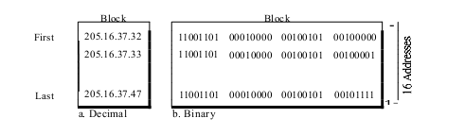
So total block is…

Slide 86


Another way….
First address
ANDing the given address with the mask
Last address
ORing the given address with the compliment of mask
No of addresses
Complimenting the mask, interpret as an integer and adding 1
15+1=16

Slide 87
Network address
When an organization is given a block of addresses, the organization is free to allocate the addresses to the devices that need to be connected to the Internet
The first address in the block is normally not assigned to any device
The first address is called the network address and defines the organization network
It defines the organization itself to the rest of the world.
first address is the one that is used by routers to direct the message sent to the organization from the outside.

Slide 88
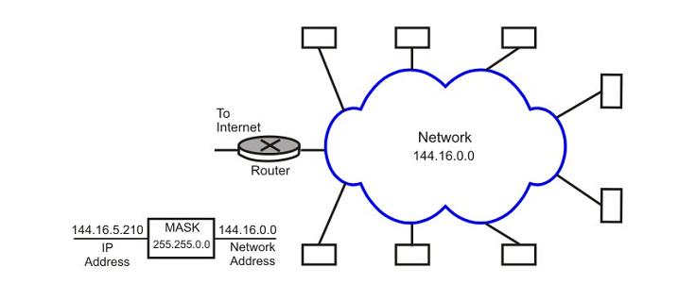
SUBNETTING
Masking filters the netid and hostid (ANDing)
All the hosts in that network must have same network number
This property of IP addressing causes problem as the network grows

Slide 89
SUBNETTING
To overcome this problem, a concept known as subnets is used, which splits a network into several parts for internal use, but still acts like a single network to the outside world
To facilitate this, a concept called subnet mask is used.
A part of hostid is used as subnet address with a corresponding subnet mask
IP addresses are designed with two levels of hierarchy but subnetting allows three levels of hierarchy (net, subnet, host)

Slide 90
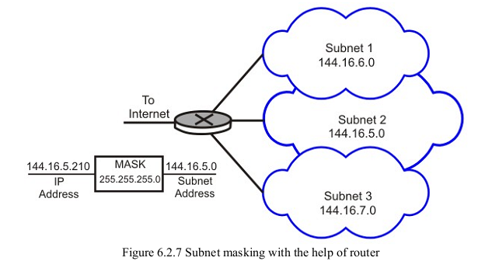
SUBNETTING

Slide 91
SUBNETTING
All messages are sent to the router address that connects the organization to the rest of the Internet; the router routes the message to the appropriate subnets.

Slide 92
Finding subnet address
What is the subnetwork address if the destination address is 200.45.34.56 and subnet mask is 255.255.240.0?
Address 11001000 00101101 00100010 00111000
Subnet mask 11111111 11111111 11110000 00000000
Subnet address 11001000 00101101 00100000 00000000
So subnet address is 200.45.32.0

Slide 93
Default mask and subnet mask
The number of 1’s in a default mask is pre determined (/8,/16,/24)
In a subnet mask, the number of 1’s is more than the number of 1’s in corresponding default mask.
Example
255.255.0.0: 11111111 11111111 00000000 00000000, default mask
255.255.224.0: 11111111 11111111 11100000 00000000, subnet mask

Slide 94
Default mask and subnet mask
Number of sub networks can be found by counting extra 1’s that are added to the default mask to make the subnet mask. For example, in earlier case, no of extra 1’s is 3, so the number of subnets is 8.
The number of addresses per subnetwork can be found by counting the number of 0’s in the subnet mask. Here, it is 13, the no of possible addresses in each subnet is 8192.
The first address in each subnet (ie.e. with hostid all 0’s) is the subnetwork address
The last address in each subnet (i.e. with hostid all 1’s) is reserved for broadcast inside the subnet.

Slide 95
IP
Widely supported network layer protocol for the internet.
IP is one the protocols in the TCP/IP protocol suite.
IP is an unreliable and connectionless protocol.
It defines and routes datagrams across the internet and provides connectionless service. This means that each datagram is handled independently and each datagram can follow different route to the destination. This implies the datagrams sent by the same source to the same destination could arrive out of order. Also some could be lost or corrupted during transmission. Again IP, relies on a higher level protocols to take care of all these problems.
IP protocol uses packet switching and makes best effort to deliver its packets.
By best effort we mean that there is no error and flow control

Slide 96
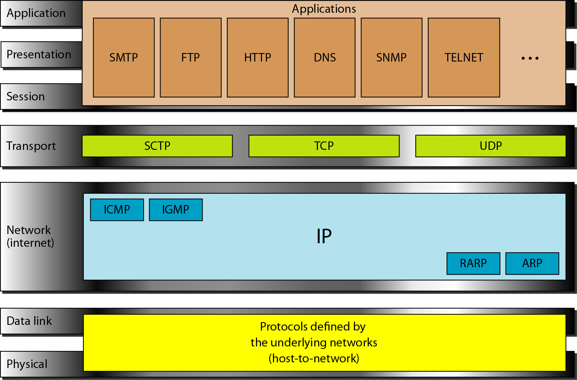
IP

Slide 97
IP
IP performs error detection and discards a packet, if it is corrupted.
To achieve reliability, it is necessary to combine it with a reliable protocol such as TCP.
Packets in IP layer are called datagrams.
The IP header provides information about various functions the IP performs.

Slide 98
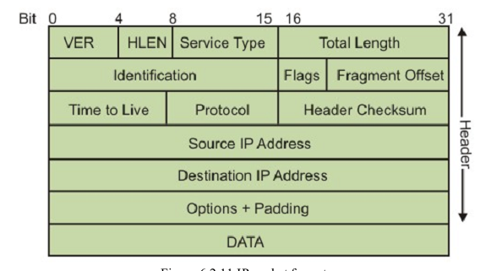
IP Packet format

Slide 99
IP Packet Format
A datagram is a variable-length packet consisting of two parts: header and data.
The header is 20 to 60 bytes in length and contains information essential to routing and delivery.
VER: 4 bit field defines the version of the IP protocol. Currently the version is 4
HLEN: This 4-bit field defines the total length of the datagram header in 4-byte words. This field is needed because the length of the header is variable (between 20 and 60 bytes). When there are no options, the header length is 20 bytes, and the value of this field is 5 (5 x 4 = 20). When the option field is at its maximum size, the value of this field is 15 (15 x 4 = 60).

Slide 100
IP Packet Format
Service type:
now called differentiated services.
8 bit field
Allow packets to be assigned a priority
Router can use this field to route packets
Not universally used

Slide 101
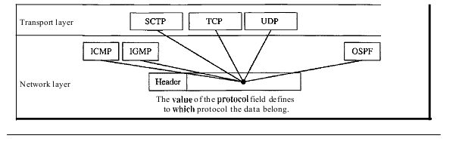
IP packet format
Total length (16 bits): length in bytes of the datagram including headers. Maximum datagram size is (216) 65536 bytes.
Time to Live (8 bits): Prevents a packet from traveling forever in a loop. Senders sets a value, that is decremented at each hop. If it reaches zero, packet is discarded.
Protocol: Defines the higher level protocol that uses the service of the IP layer. An IPv4 datagram can encapsulate data from several higher-level protocols such as TCP, UDP, ICMP, and IGMP. This field specifies the final destination protocol to which the IPv4 datagram is delivered.
Identification, Flags, Fragment Offs et: Used for handling fragmentation.

Slide 102
Continues..
Source IP address (32 bits): Internet address of the sender.
Destination IP address (32 bits): Internet address of the destination.
Checksum: the checksum in the IP packet covers only the header, not the data. All higher level protocols that encapsulate data in the IP datagram have a checksum field that covers the whole packet. So checksum for IP datagram doesn’t have to check the encapsulated data. Second, the header of IP packet changes with each visited router, but the data don’t.

Slide 103
IPV6
Deficiencies of IPV4
IPV4 has a two level address structure (netid and hostid) categorized into five classes (A, B, C, D and E). The use of address space is insufficient.
The internet must accommodate real time audio and video transmission. This type of transmission requires minimum delay strategies and reservation of resources not provided in the IPV4 design.
The internet must accommodate encryption and authentication of data for some applications. Originally, no security mechanism was provided by IPV4

Slide 104
IPV6 (IPng)
Advantages of IPV6 over IPV4
larger address space: an IPV6 is 128 bits long. Increase in pow(2,96) address space.
Better header format
New options: to allow for additional functionalities
Allowance fro extension: IPV6 is designed to allow the extension of the protocol if required by new applications.
Support for resource allocation: type of service is removed. Flow label is added. It can be used to support traffic such as real time audio and video.
Support for more security: encryption and authentication options in IPV6 provide confidentiality and integrity of the packets.

Slide 105
IPV6 packet format
0
4
8
16
24
31
V
ersion
Traffic Class
Flow Label
Payload Lengtht
Next Header
Hop Limit
SourceAddr (4 words)
DestinationAddr (4 words)
Options (variable number)
Data

Slide 106
IPV6
Version: 4 bit field. Version no of the IP, for IPV6, the value is 6
Priority (4 bit): defines the priority of the packet with respect to traffic congestion.
Flow label (24 bits): to provide special handling for a particular flow of data
Payload length: The 2-byte payload length field defines the length of the IP datagram excluding the base header.
Next header: The next header is an 8-bit field defining the header that follows the base header in the datagram. The next header is either one of the optional exten-sion headers used by IP or the header of an encapsulated packet such as UDP or TCP

Slide 107
IPV6
Hop limit: 8 bit hop limit field serves the same purpose as the TTL (time to live) field in IPV4
Source address: the source address field is 16 byte internet address that identifies the original source of the datagram.
Destination address: it is a 16 byte internet address that usually identifies the final destination of the datagram. However, if source routing is used, this field contains the address of the next router.

Slide 108
ARP-Address resolution protocol
Anytime a host or a router, needs to find the MAC address of another host or router on its network, it sends an ARP query packet.
The packet includes the physical and IP address of the sender and IP address of the receiver.
Coz the sender does not know the physical address of the receiver, the query is broadcast over the network.
Every host or router on the network receives and processes the ARP query packet, but only the intended recipient recognizes its IP address and sends back an ARP response packet. The response packet contains the recipient’s IP and physical addresses.
The packet is unicast directly to the inquirer using the physical address received in the query packet.

Slide 109
Address Translation with ARP

Slide 110
Address Translation with ARP

Slide 111
ARP Packet Format

Slide 112
ARP packet
HTYPE: type of network on which ARP is running. Each LAN is assigned an integer based on its type. Eg Ethernet is given type 1.
PTYPE: defines protocol using ARP. Eg the value of this field for IPV4 is 0800
HLEN: length of physical address in bytes. Eg for Ethernet it is 6.
PLEN: length of the IP address in bytes. Eg for IPV4, IT IS 4
OPER: defines the type of packet. Two packets (ARP request (1), ARP reply (2))
SHA: variable length field. Defines the physical address of sender. Eg Ethernet it is 6 bytes long
SPA: variable length field. Defines the logical address of sender. Eg 4 bytes.
THA:
TPA

Slide 113
ICMP-Internet Control Message Protocol
IP protocol is a best effort delivery service that delivers a datagram from its original source to its final destination. However it has two deficiencies.
Lack of error control
Lack of assistance mechanism
The IP protocol has no error-reporting or error-correcting mechanism
What happens if a router must discard a datagram because it cannot find a router to the final destination
What happens if the final destination host must discard all fragments of a datagram because it has not received all fragments within a predetermined time limit?
A host sometimes needs to determine if a router or another host is alive. And sometimes a network administrator needs information from another host or router.
The Internet Control Message Protocol (ICMP) has been designed to compensate for the above two deficiencies.
It is a companion to the IP protoco1

Slide 114
ICMP
ICMP
IGMP
IP
ARP
RARP
ICMP itself is network layer protocol. However, its messages are not passed directly to the data link layer instead, the messages are first encapsulated inside IP datagrams before going go the lower layer. The value of the protocol field in the IP datagram is 1, to indicate that IP data is an ICMP message.
ICMP message
Error reporting message
Query message

Slide 115
ICMP
Error reporting Messages: Destination unreachable, Time exceeded, Source quench, Parameter problems, Redirect
Query message: Echo request and reply, Timestamp request and reply, Address mask request and reply
The query messages, which occur in pairs, help a host or a network manager get specific information from a router or another host. For example, nodes can discover their neighbors. Also, hosts can discover and learn about routers on their network, and routers can help a node redirect its messages.

Slide 116
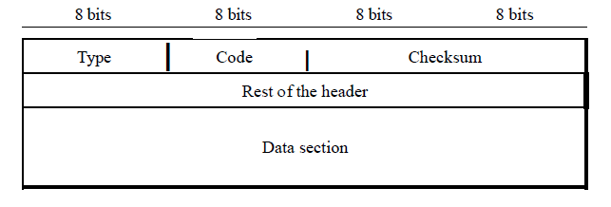
ICMP message format
Type: it defines the type of the message
The code field specifies the reason for the particular message type
The last common field is the checksum field. The rest of the header is specific for each message type.
The data section in error messages carries information for finding the original packet that had the error. In query messages, the data section carries extra information based on the type of the query.

Slide 117
Error reporting message- ICMP doesn’t correct errors it simply reports them. Error correction is left to the higher level protocols.
When a router can’t route a datagram or a host can’t deliver a datagram, the datagram is discarded and the router/host sends a destination unreachable message back to the source host that initiated the datagram.
No flow control mechanism in IP. May create congestion in routers. Router has limited size queue for incoming datagram. If the datagram are received much faster than they can be processed, overflow. Discard few datagram. Source quench message adds kind of flow control to the IP. When a router discards a datagram due to congestion, it sends a source quench message to the sender of the datagram. This message has two purposes.
It informs the source that datagram has been discarded.
It warns the source that there is a congestion somewhere in the path and source should slow down the sending process.
Destination unreachable
Source quench
Time exceeded
Parameter problems
redirection

Slide 118
Error reporting message
Time exceeded: time exceeded message is generated in two cases.
Whenever a router receives a datagram with a time to live value of zero, it discards the datagram and sends time exceeded message to the sender.
When the final destination doesn’t receive all the fragments in a set time.
Parameter problem: if a router discovers an ambiguous or missing value in any field of the datagram, it discards the datagram and sends a parameter problem message back to the source.

Slide 119
Query message
Are designed for diagnostic purposes. Used to identify network problems. It determines whether two systems can communicate with each other. PING COMMAND
2. Two machines can use the timestamp request and reply message to determine the sound-trip time needed for an IP datagram to travel between them. It is also used to synchronize the clocks in two machines.
3. IP address=network address + subnet address and host identifier. A host may know its full IP address, but it may not know which part of the address defines the net, subnet and host identifier. To obtain its mask, a host sends a address mask request message to a router on the LAN. The router receiving the address mask request message responds with an address mask reply message providing the necessary mask for the host. This can be applied to its full IP address to get its subnet address.
Echo request and reply
Time stamp request and reply
Address mask request and reply

Slide 120
IGMP
IP provides unicasting and multicasting services.
Some processes sometimes need to send the same message to a large number of receivers simultaneously. This is called multicasting, which is a one-to-many communication
Multicasting has many applications
For example, multiple stockbrokers can simultaneously be informed of changes in a stock price, or travel agents can be informed of a plane cancellation. Some other applications include distance learning and video-on-demand.
The Internet Group Management Protocol (IGMP) is one of the necessary, but not sufficient, protocols that is involved in multicasting.
IGMP is a companion to the IP protocol
IGMP has there types of message
General query
Special query
Membership query
Leave query

Slide 121
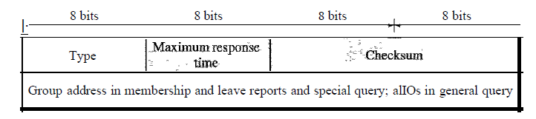
IGMP message
Type: defines the type of message
Maximum response time: defines an amount of time in which query must be answered.
Checksum
Group address
General query: which groups have members on an attached network
Special query: to learn if a particular group has any members on an attached network.
Membership report: sent by a multicast host to signal participation in a specific multicast host group.
Leave report: specifies a leave group packet.

Slide 122
Transport Layer Protocols
TCP, UDP

Slide 123
Transport layer protocols
From user’s point of view, the TCP/IP-based internet can be considered as a set of application programs that use the internet to carry out useful communication tasks.
Most popular internet applications include Electronic mail, File transfer, and Remote login
. IP allows transfer of IP datagrams among a number of stations or hosts, where the datagram is routed through the internet based on the IP address of the destination.
But, in this case, several application programs (processes) simultaneously running on a source host has to communicate with the corresponding processes running on a remote destination host through the internet.
This requires an additional mechanism called process-to-process delivery, which is implemented with the help of a transport-level protocol.
The transport level protocol will require an additional address, known as port number, to select a particular process among multiple processes running on the destination host. So, there is a requirement of the following third type of delivery system.

Slide 124
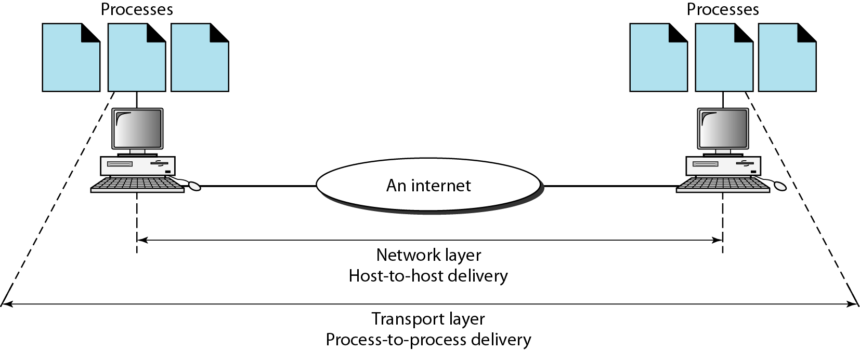
Process to process delivery
Data link layer: host to host delivery
Network layer: source to destination delivery
Communication on the Internet is not defined as the exchange of data between two nodes or between two hosts. Real communication takes place between two processes (application programs).
We need process-to-process delivery
The transport layer is responsible for process-to-process delivery-the delivery of a packet, part of a message, from one process to another.
Two processes communicate in a client/server relationship

Slide 125
Addressing
Data link layer (MAC address), network layer (IP address) and at transport layer, we need transport address called PORT ADDRESS to choose among multiple processes running on destination host.
In the Internet model, the port numbers are 16-bit integers between 0 and 65,535.
Used by host t0 host protocol to identify to which higher level protocol or application program(process) it must deliver incoming messages.
The lANA (Internet Assigned Number Authority) has divided the port numbers into three ranges: well known, registered, and dynamic
Well-known ports. The ports ranging from 0 to 1023 are assigned and controlled by lANA. These are the well-known ports.
Registered ports. The ports ranging from 1024 to 49,151 are not assigned or controlled by lANA. They can only be registered with lANA to prevent duplication.
Dynamic ports. The ports ranging from 49,152 to 65,535 are neither controlled nor registered. They can be used by any process. These are the ephemeral ports.

Slide 126
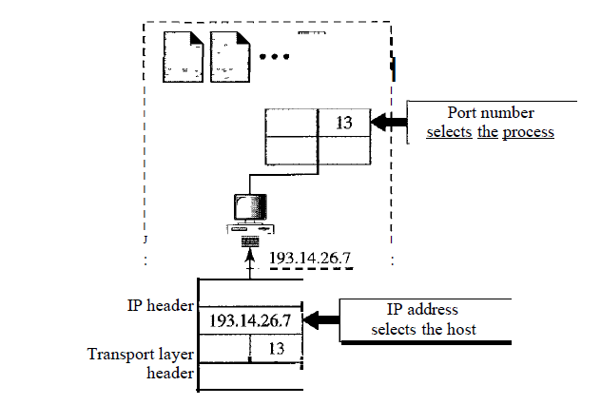
IP address vs Port number

Slide 127
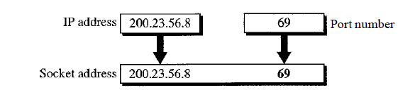
SOCKET
Process-to-process delivery needs two identifiers, IP address and the port number, at each end to make a connection
The combination of an IP address and a port number is called a socket address
The client socket address defines the client process uniquely just as the server socket address defines the server process uniquely
A transport layer protocol needs a pair of socket addresses: the client socket address and the server socket address. These four pieces of information are part of the IP header and the transport layer protocol header.
The IP header contains the IP addresses; the UDP or TCP header contains the port numbers.

Slide 128
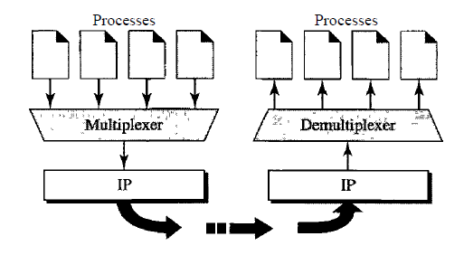
MUX and DEMUX
The addressing mechanism allows multiplexing and demultiplexing by the transport layer
At the sender site, there may be several processes that need to send packets. However, there is only one transport layer protocol at any time. This is a many-to-one relationship and requires multiplexing
At the receiver site, the relationship is one-to-many and requires demultiplexing. The transport layer receives datagrams from the network layer. After error checking and dropping of the header, the transport layer delivers each message to the appropriate process based on the port number.

Slide 129
Connectionless vs conxn oriented services
Connection less service
Connection oriented service
Connectionless
The packets are sent from one party to another with no need for connection establishment or connection release
The packets are not numbered; they may be delayed or lost or may arrive out of sequence.
There is no acknowledgment either
UDP
In a connection-oriented service, a connection is first established between the sender and the receiver.
Data are transferred.
At the end, the connection is released.
TCP and SCTP

Slide 130
Reliable vs unreliable services
Transport layer service may be reliable and unreliable
If application needs reliability, we use a reliable transport layer protocol by implementing flow and error control at the transport layer. This means a slower and more complex service.
In opposite case, unreliable protocols are used.
Connection oriented protocols are reliable and connection less protocols are unreliable.
Reliable : TCP and SCTP
Unreliable: UDP

Slide 131
UDP
Simple, unreliable transport layer protocol
Connectionless, unreliable transport protocol
It does not add anything to the services of IP except for providing process to process communication instead of host to host communication.
It performs very limited error checking
If a process wants to send a small message and doesn’t care much about reliability, it can use UDP
UDP is convenient protocol for multimedia and multicasting applications

Slide 132
UDP
UDP is responsible for differentiating among multiple source and destination processes within one host. Multiplexing and demultiplexing operations are performed using the port mechanism as

Slide 133
UDP-port numbers
UDP uses port numbers as the addressing mechanisam in the transport layer.
Well-known ports (0-1023)
Registered ports (1024-49151)
Dynamic ports (49152-65535)

Slide 134
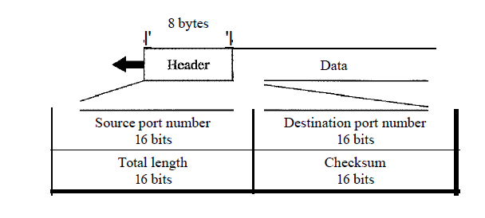
USER DATAGRAM
Source port (16 bits): It defines the port number used by the process running on the source host. It can range from 0-65535
Destination port (16 bits): It defines the port number used by the process running on the destination .
Length: This is a 16 bit field that defines the total length of the user datagram, header plus data.
Checksum: It is used to detect errors over the entire user datagram. It ensures the integrity of data. It is optional. If not calculated, the field is filled with 0s.
UDP packets, called user datagram, have a fixed size header of 8 bytes. Figure shows the format of user datagram

Slide 135
Applications
UDP is suitable for a process that requires simple request response communication with little concern for flow and error control. It is not used for a process that needs to send bulk data, such as FTP.
Suitable for multicasting. Multicasting capabilities are embedded in the UDP software but not in the TCP software.
UDP is used for some route updating protocols such as routing information protocol (RIP)
UDP is used in conjunction with the real time transport protocol (RTP) to provide a transport layer mechanism for real time data.

Slide 136
TCP
TCP provides a connection-oriented, full-duplex, reliable, streamed delivery service using IP to transport messages between two processes.
It adds connection-oriented and reliability features to the services of IP
Reliability is ensured by:
Connection-oriented service
Flow control using sliding window protocol
Error detection using checksum
Error control using go-back-N ARQ technique
Congestion avoidance algorithms; multiplicative decrease and slow-start

Slide 137
TCP Datagram

Slide 138
TCP Datagram
Source port (16 bits): It defines the port number of the application program in the host of the sender
Destination port (16 bits): It defines the port number of the application program in the host of the receiver
Sequence number (32 bits):
It conveys the receiving host which octet in this sequence comprises the first byte in the segment
Specifies position of transmitting data in original data stream
Acknowledgement number (32 bits): This specifies the sequence number of the next octet that receiver expects to receive
HLEN (4 bits): This field specifies the number of 32-bit words present in the TCP header
Control flag bits (6 bits): URG: Urgent pointer: says where non urgrnt data strats

Slide 139
TCP Datagram
ACK: Indicates whether acknowledge field is valid
• PSH: Push the data without buffering
• RST: Resent the connection
• SYN: Synchronize sequence numbers during connection establishment
• FIN: Terminate the connection
• Window (16 bits): Specifies the size of window
• Checksum (16 bits): Checksum used for error detection.
• User pointer (16 bits): Used only when URG flag is valid
• Options: Optional 40 bytes of information

Slide 140
SERVICES offered by TCP
Process to process communication
Like UDP, TCP provides process-to-process communication using port numbers. Table lists some well-known port numbers used by TCP

Slide 141
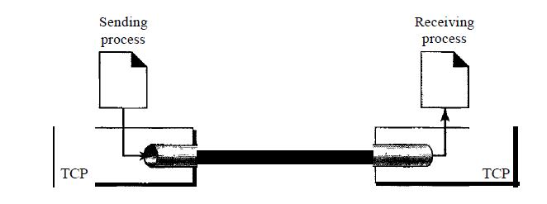
TCP SERVICE
TCP, on the other hand, allows the sending process to deliver data as a stream of bytes and allows the receiving process to obtain data as a stream of bytes. TCP creates an environment in which the two processes seem to be connected by an imaginary "tube“ that carries their data across the Internet. This imaginary environment is depicted in Figure. The sending process produces (writes to) the stream of bytes, and the receiving process consumes (reads from) them.

Slide 142
TCP services
Full duplex communication
Connection oriented services
TCP offers full-duplex service, in which data can flow in both directions at the same time
Reliable services
TCP is a reliable transport protocol. It uses an acknowledgment mechanism to check the safe and sound arrival of data
TCP, unlike UDP, is a connection-oriented protocol. When a process at site A wants to send and receive data from another process at site B, the following occurs:
The two TCPs establish a connection between them.
Data are exchanged in both directions.
The connection is terminated.

Slide 143
TCP VS UDP
Reliability: TCP is connection-oriented protocol. When a file or message send it will get delivered unless connections fails. If connection lost, the server will request the lost part. There is no corruption while transferring a message.
Ordered: If you send two messages along a connection, one after the other, you know the first message will get there first. You don't have to worry about data arriving in the wrong order
Streaming: Data is read as a "stream," with nothing distinguishing where one packet ends and another begins. There may be multiple packets per read call
Examples: World Wide Web (Apache TCP port 80), e-mail (SMTP TCP port 25 Postfix MTA), File Transfer Protocol (FTP port 21) and Secure Shell (OpenSSH port 22) etc
Reliability: UDP is connectionless protocol. When you a send a data or message, you don't know if it'll get there, it could get lost on the way. There may be corruption while transferring a message
Ordered: If you send two messages out, you don't know what order they'll arrive in i.e. no ordered
Datagrams: Packets are sent individually and are guaranteed to be whole if they arrive. One packet per one read call
Examples: Domain Name System (DNS UDP port 53), streaming media applications such as IPTV or movies, Voice over IP (VoIP), Trivial File Transfer Protocol (TFTP) and online multiplayer games etc

